Slide 1
Create reproducible and accessible Excel data files
Coffee and Coding
Georgina Anderson
23rd February 2023
Georgina Anderson 23/02/2023
1

Slide 2
Content
Publishing Excel data to accompany a report
Best practice requirements and guidance
The manual process
a11ytables as an automated solution for R
Python alternatives
2

Slide 3
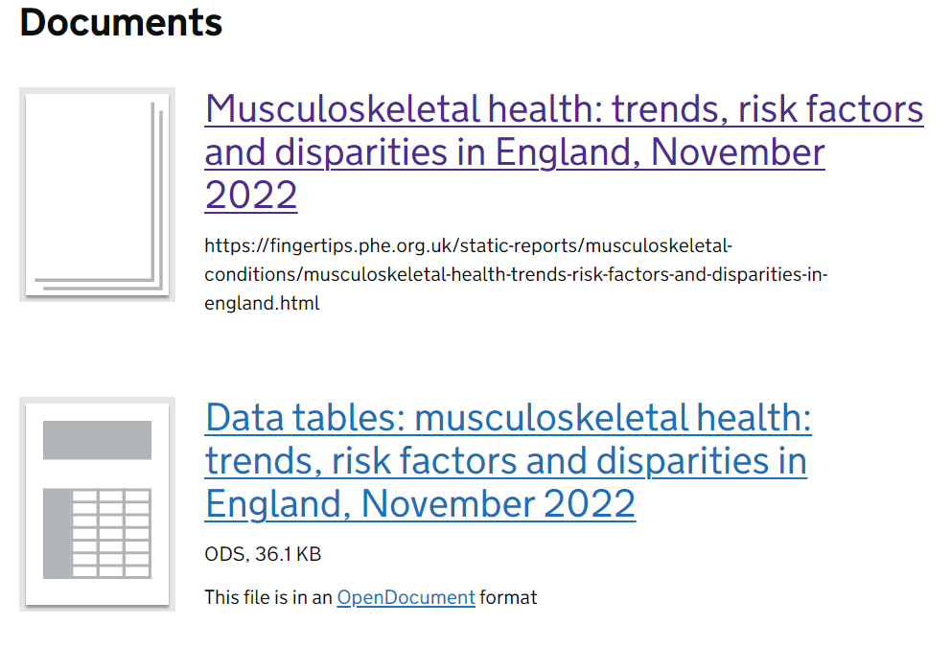
Publishing Excel data to accompany a report
https://www.gov.uk/government/statistics/musculoskeletal-health-trends-risk-factors-and-disparities-in-england-november-2022
3

Slide 4
Government Best Practice Guidance
Statistics Authority publications:
Code of Practice for Statistics
https://code.statisticsauthority.gov.uk/
Government Analysis Function publications:
Releasing statistics in spreadsheets
https://analysisfunction.civilservice.gov.uk/policy-store/releasing-statistics-in-spreadsheets/
Making spreadsheets accessible: a checklist of the basics
https://analysisfunction.civilservice.gov.uk/policy-store/making-spreadsheets-accessible-a-brief-checklist-of-the-basics/
4

Slide 5
Accessibility requirements for Excel data – workbook level
Requirement checklist | Priority
Have you removed all blank worksheets? | Essential
Do all your worksheets have unique names or numbers in the tabs along the bottom? | Essential
If any of your worksheets have subheadings have you tagged them correctly? Remember, second level subheadings should be a Headings 2, third level a Headings 3 and so on | Essential
Have you added document information? | Essential
Have you run a spelling and grammar check? It is in the Review ribbon. | Essential
Have you used Excel's accessibility checker? Remember it isn't perfect but it will flag up some things you may have missed. | Good to do
Did you ensure the cursor was in cell A1 of the first worksheet when you did your final save? | Good to do
5

Slide 6
Accessibility requirements for Excel data – worksheet level
Requirement checklist | Priority
Is the worksheet heading in cell A1? | Essential
Have you tagged the worksheet heading as a 'Headings 1' using the cell styles tool on the Home ribbon? | Essential
Are all tables on the worksheet marked-up using the insert table tool? | Essential
Do all the tables have one marked-up header row? | Essential
Have all merged cells, split cells and nested tables been removed? | Essential
Have all blank rows and columns within tables been removed? | Essential
Is all text visible and spaced out? | Essential
If you have used filters or freeze panes have you made it clear they are switched on and explained how to switch them off using a mouse and keyboard shortcuts? | Essential
Have you checked all blank cells meet the criteria and is the appropriate guidance provided? | Essential
Have you replaced all symbols with the appropriate shorthand as outlined in our 'Using symbols and shorthand' guidance? % and £ are OK. | Essential
6

Slide 7
Accessibility requirements for Excel data – worksheet level
Requirement checklist (continued) | Priority
Do all hyperlinks have descriptive link text? | Essential
Is the hyperlink text the default blue colour? It is OK to leave hyperlink text the default blue colour. Hyperlink text should also be underlined (even though underline is discouraged in all other situations). | Essential
Have you ensured colour has not been used as the only way to communicate a message? | Essential
When you have used colour for emphasis have you ensured the contrast between the text and the background meets the required standard? | Essential
Have you removed any headers, footers, floating text boxes or floating toolbars? | Essential
Have you avoided the use of images? If you have images have you ensured they have alternative text? | Essential
Are all tables positioned against the left-hand edge of each sheet? Remember, you should not use blank columns to create space. | Essential
If your worksheet has multiple tables have you made sure to read and follow this section of the main spreadsheet guidance? | Essential
Is the worksheet heading descriptive - can non-experts understand what is on this worksheet? | Good to do
Have you edited the default formatting of the heading and any subheadings? Ideally you should select the 'automatic' font colour and take off the cell border. | Good to do
7

Slide 8
Accessibility requirements for Excel data – worksheet level
Requirement checklist (continued) | Priority
Does cell A2 have a description of what is on this worksheet? For example "This worksheet contains one table, some cells refer to notes which can be found on the notes worksheet" | Good to do
Is the table marked up with a meaningful name? This can be done by clicking into a marked-up table and then onto the Design ribbon. | Good to do
Have you set the background fill to 'No fill'? Note - if you don't like the gridlines that appear when you remove the fill, these can be switched off in the View ribbon. | Good to do
If a table refers to notes, have you clearly explained where notes can be found in a cell in column A, above the table? | Good to do
Is all text a sans serif font (e.g. Arial or Calibri) | Good to do
Have you removed any italic text? | Good to do
Have you limited your use of cell borders? | Good to do
Have you removed any macros? | Good to do
8

Slide 9
Meeting the requirements without a tool to help……
Whether data was created directly in Excel or exported programmatically, accessibility amendments would almost always include:
Marking up tables
Naming worksheets
Adding table titles & sources
Creating a Cover sheet
Creating a Contents sheet
Creating a Notes reference sheet
Additionally, if data has already been prettified, it may be necessary to undo these changes by removing non-default formatting such as merged cells, shading, borders, blank cells
Not reproducible ….
And although intention is to do this once only on the final document, can end up being done many times over
9

Slide 10
a11ytables as an automated solution for R
Exports data tables from R to Excel
Automatically generates
Cover sheet
Contents sheet
Notes sheet
Marks up all tables
Names all worksheets and cross references in Contents sheet
Applies notes and cross references in Notes sheet
Avoids use of inaccessible fonts and formatting
And does this in a reproducible way
10

Slide 11
Using a11ytables
Documentation: https://co-analysis.github.io/a11ytables/
Code: https://github.com/co-analysis/a11ytables/
Demo: Use a11ytables R Studio Addin to create customisable script:
“Insert full ‘a11ytables’ template workflow”
11

Slide 12
Using a11ytables (2)
Workflow Task | Code
Create data frame containing all spreadsheet content | create_a11ytable( tab_titles, sheet_types, sheet_titles, # required char vectors blank_cells, sources, # optional char vectors tables # required data frames ) |> generate_workbook() |> openxlsx::saveWorkbook()
Convert to openxlsx’s ‘Workbook’ class (add spreadsheet structure and styles) | a11ytables::generate_workbook()
Write to Excel | openxlsx::saveWorkbook()
12

Slide 13
Words of caution
Best practice that’s not in scope (or not that I’ve found…..):
Document properties must still be set manually (title, author, keywords)
Displaying numbers to a desired number of decimal places
Apply Heading 1 Style to all worksheet titles
Tables names are just numbers and user must refer back to Contents for titles
Need to re-save output if want .ods format
Grey areas in ‘best practice’
Not always agreement between package / guidance / publication team
Eg ‘This worksheet contains 1/one table’
Consider purpose of data
package aims to meet requirements for human-readable data (machine-readable requirements differ)
13

Slide 14
Further reading
Matt Dray, the package author, did a more comprehensive presentation on the {a11ytables} package to the NHS-R community, January 2023:
Create reproducible and accessible spreadsheets with {a11ytables}
Presentation slides online: https://matt-dray.github.io/earl22-presentation/
14

Slide 15
Python alternatives
gptables
Good Practice tables
Python package
Published by the Government Analysis Function on PyPI
https://pypi.org/project/gptables/
Blog: https://dataingovernment.blog.gov.uk/2022/06/24/automatically-produce-best-practice-spreadsheets/
Coffee and Coding 7th September 2022
James Osmond demo
Bespoke python code to do similar task
https://github.com/DataS-DHSC/coffee-and-coding/tree/master/2022-09-07%20Python%20and%20Accessible%20Datasets
15

